Slide 1

Francois Brouet – sep24_continuous_ds
Notes:
Good afternoon, I am pleased to present to you today the results of my Data Science Project

Slide 2
Presentation
01
Context
02
Data exploration
Streamlit
03
Data visualization
04
Pre-processing
05
Result overview
06
Modelling
Streamlit
07
Next steps / Conclusion
Notes:
The presentation will be divided in the following sections: I will show you some elements in the slides and then at some points of the presentation, we will switch to streamlit
After a short introduction we will have a look at:
the data
the targets
the models
and finish with an outlook for the project

Slide 3
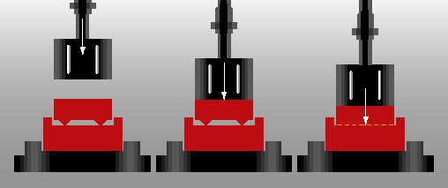
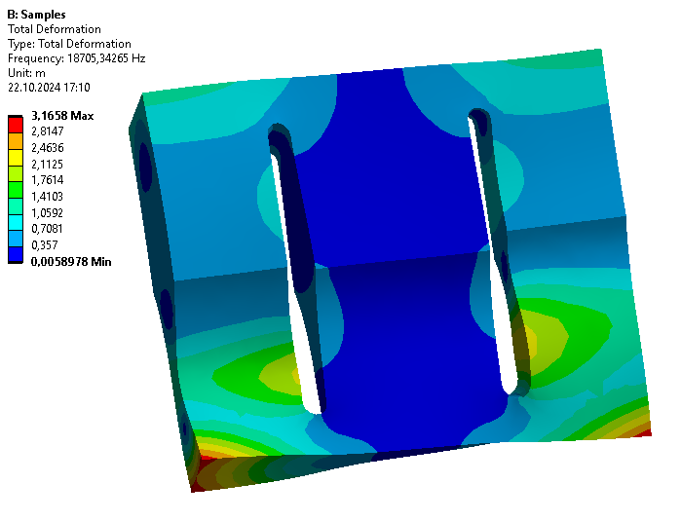
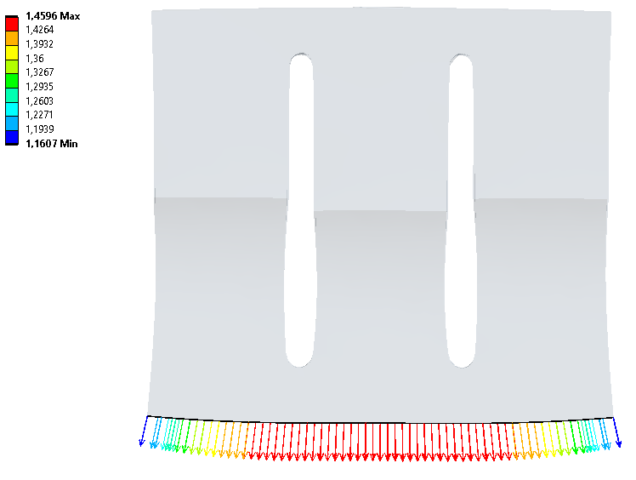
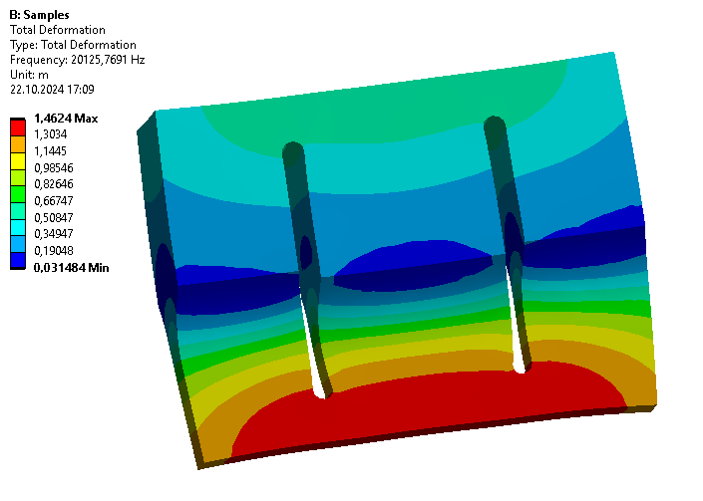

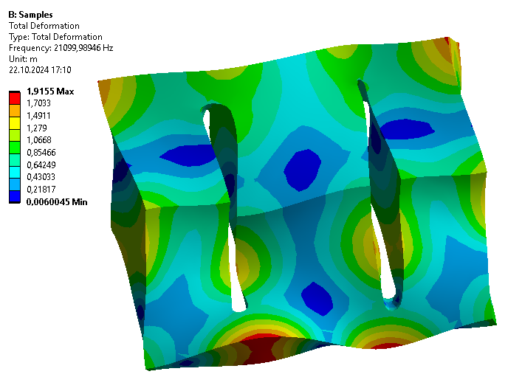
Context
Concept of the ultrasonic welding:
vibration energy → welding part
energy → heat
force → new connection
Ultrasonic sonotrode
longitudinal mode used to drive the vibration
Requirements:
frequency ~ 20 kHz
longitudinal mode isolated
uniform output displacements
Notes:
Principle of US-Welding
Mechanical vibrations transfer kinetic energy into a welding part
The surface friction transforms this energy into heat
Then the material begins to melt
A mechanical force compresses it, parallel to the melting
A new homogeneous connection is created
Sonotrode:
is in contact with the welding part
has many vibrating modes (each mode has a frequency and a deformed shape)
longitudinal mode is used
these modal properties are calculated with ANSYS (FEM software)
Requirements
Longitudinal mode‘s frequency should be close to 20 kHz (driving frequency)
Longitudinal mode should be isolated from other modes
Longitudinal mode‘s displacements should be as uniform as possible over the welding surface

Slide 4
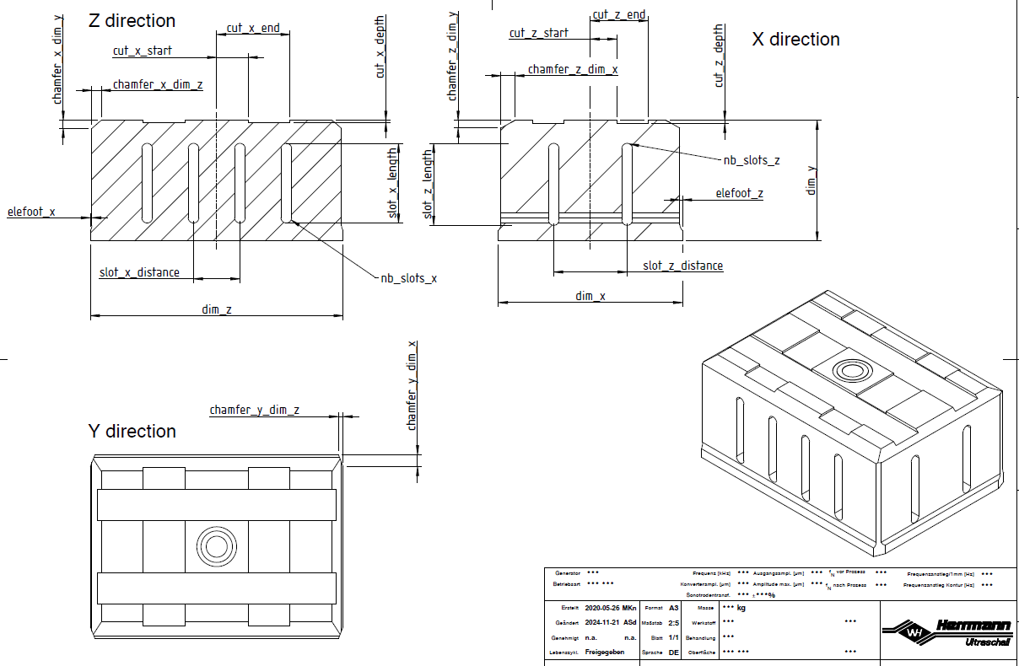
Goal
Main goal: Prediction of the FEM results from the sonotrode geometry
3 predictions:
longitudinal frequency
frequencies of all modes
uniformity of the output displacements
Geometry: 23 parameters
(dim_x) × (dim_z): output surface
(dim_y): length
…
Notes:
Goal of this project was to predict the results of FEM simulations (calculation of modal properties) without running them
Simulations of complex geometries are very computer-intensive → so one iteration can take up to an hour
FEM results are splitted in 3 subgoals (different target variables)
- Prediction of the longitudinal mode’s frequency
- Prediction of the frequencies of all other modes: in particular those near the longitudinal mode (ex: 5 modes below and 5 modes above).
- Prediction of the displacements’ uniformity (as a number), rather than all displacement values
Geometry described by 23 parameters
dim_x / dim_z welding (output) surface, are usually fixed by the welding part
dim_y: oscillation length, important feature to tune the longitudinal frequency
here: 4 slots and 2 slots in both directions
other dimensions: free, used to optimize the modal properties of the sonotrode

Slide 5
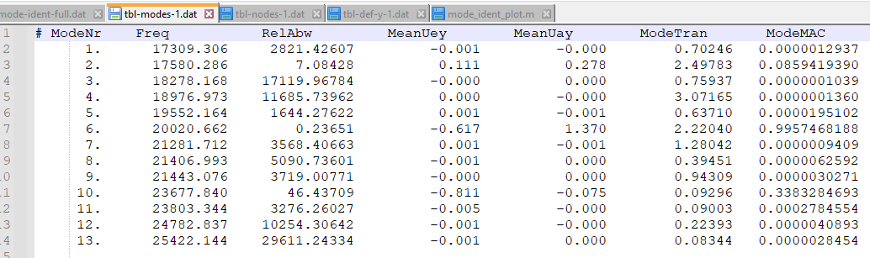
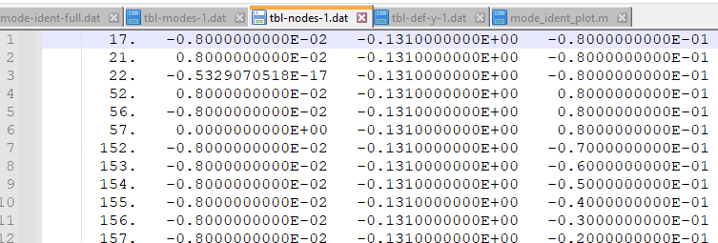
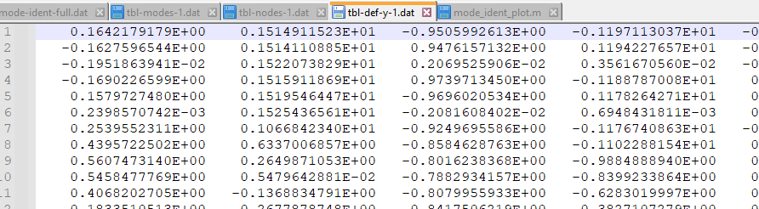
Data exploration
MAC (Modal Assurance Criterion)
comparison: mode shapes with reference longitudinal mode shape
0 no correspondance
1 full correspondance
Identification of the longitudinal mode
Long. mode: highest MAC value
8000 design points (DP) = geometries
CSV files
Notes:
Before we look at the dataset, I would like to introduce 2 important notions:
the MAC value is an indicator, that compares the calculated mode shapes with a reference shape, chosen as an ideal long. mode shape
The mode shapes are displacement vectors (for a matter of simplicity, we take only the node‘s displacements located at the input and output surfaces)
the MAC value is in a range from 0 (no correspondance with the long. mode shape at alll) to 1 (equals a perfect longitudinal mode shape)
the FEM program directly calculates the MAC value when the simulation is complete
When a simulation is complete and all modes have been calculated, the long. mode is found by comparing the MAC value of each mode.
The mode with the highest value is marked as the long. mode. The mode number can change between 2 geometries.
A design point represents a distinct geometry as a 23-dimensional vector. Before starting the project, I generated the DPs randomly within a defined parameter space, to ensure valid sonotrode geometries.
There are about 8000 DPs. The data was stored in CSV files written by the FEM program.
During the data collection step, I imported the 24,000 CSV files into 4 dataframes, that we will see now in streamlit

Slide 6
Data exploration
(Streamlit)
Notes:
* Exploration of the data
There are 4 dataframes:
- parameters (concatenation of 3 groups of columns)
(columns)
* 1st part contains geometric parameters
* second part contains the identification features of the long mode
* final part contains the additional features (see later: slot class, uniformity criterion, frequency isolation)
(rows)
DP (here only 100)
- modes: all combinations of DP and mode numbers
Start with DP 1001, all modes from position 25 to position 100
For each mode we get some properties: frequency, MAC
- nodes: all combinations of DP and nodes
Node coordinates XYZ located on the output surface
- displacements: largest dataframe
contains the same combination of DP / nodes but for all modes 25 to 100
Let‘s move on to the
* Data visualization
We start with the distribution of the explanatory variables: the geometric parameters are distributed according a normal distribution
→ boxplots are symmetrical, median in the center and equal-length whiskers on both sides
slot_x_distance and slot_z_distance have a skew distribution → they are depending on the variable number of slots
Example of DP 1001:
You see in the dataframe extracts from the geometric parameters
Identified long. mode is mode 77, why?
- In the mode list:
MAC value 0.92 maximal for mode 77
Long. frequency is frequency of mode 77: 19218
Delta frequency to the next mode is only 61 Hz
Now let‘s see the displacements for these 3 modes
Displacements of mode 77 are not perfectly uniform (although they have the same sign)

Slide 7
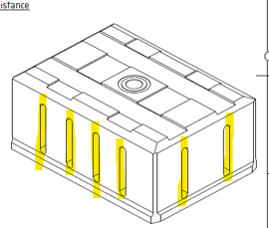
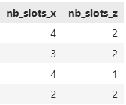



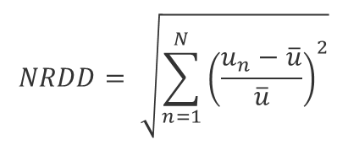
Pre-processing
Slot classes
NRDD
Norm of the Relative Displacement Deviation
width (x)
depth (z)
$$NRDD= \sqrt{\sum_{n=1}^{N}{{\left(\frac{u_{n}−\overline{u}}{\overline{u}}\right)}^{2}}}$$
$$u_{n}$$
displacement of the node n
average of all displacements
number of nodes (output surface)
$$\overline{u}$$
$$N$$
Notes:
I added new features to the dataset
The sonotrode needs slots in both directions for acoustic reasons, the number of slots is variable. During the DP generation, I used 4 combinations of slot distributions.
The width (largest dimension) needs more slots than the depth.
The numbers of slots in both directions are categorical and building a class with 4 values
The prediction of the output displacements themselves did not turn out accurate. Since the 3rd goal is to predict only the uniformity, I introduced a new metric to evaluate the displacements‘ uniformity.
The Norm of the Relative Displacement Deviation (called NRDD) is obtained:
by taking the relative difference of each node‘s displacements and the average
squarring and summing these differences
taking the square root of the result

Slide 8
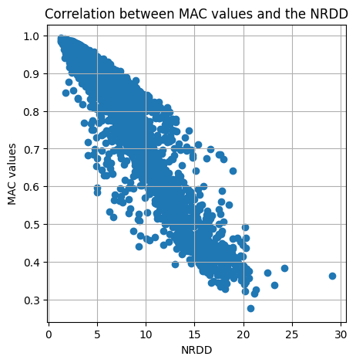
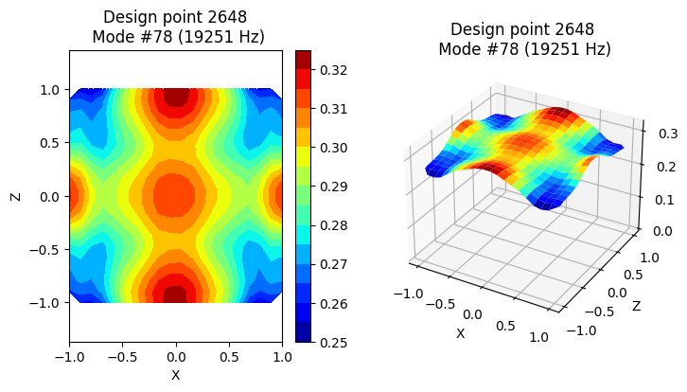
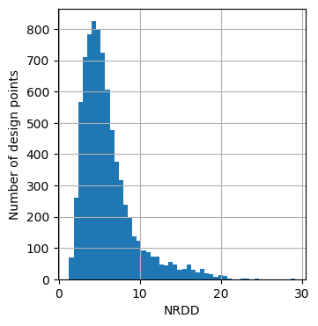
Pre-processing
NRDD = 0 perfect uniform displacements
NRDD > 10 poor uniformity
(NRDD = 1.3)
Notes:
A low value of NRDD corresponds to uniform displacements, while high values indicate poor uniformities (the deviations are significant)
As an example, you see on the left the DP with the most uniform displacements: NRDD = 1.3
The graphs on the right shows
the correlation between the MAC values and the new metric NRDD
the distribution of NRDD
You might wonder why I chose the NRDD as target variable, rather than MAC. The answer is that the models performed slightly better with NRDD than with MAC.
So I decided to continue in this direction.

Slide 9
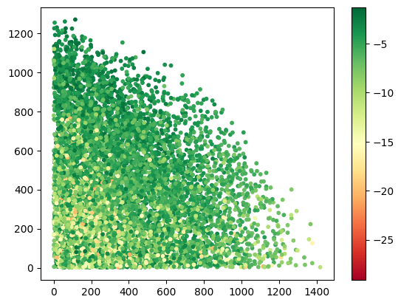
Pre-processing
Frequencies above / below
Delta frequency above [Hz]
None of the design points has a long. mode isolated on both sides with more than 800 Hz
Color information = NRDD
Delta frequency below [Hz]

Slide 10
Result overview
Target variable(s) | Best estimator | Final R² score | Mean Absolute Error
Frequency of the longitudinal mode | LightGBM | 0.997 | 21 Hz
All frequencies | LightGBM | 0.998 | 98 Hz
Displacements of the longitudinal mode | Keras Neural Network | 0.855
Notes:
I won‘t present all the models tested in this work but you can see in the overview table the best results achieved for the 3 targets:
- predictions of the frequencies were performed with the Light Gradient-Boosting Machine algorithm
- prediction of the uniformity was achieved with a Keras Neural Network with Dense layers
For the rest of the presentation, we will focus on Streamlit on the longitudinal frequencies:
the target is a single value (contrary to all frequencies and displacements)
the score and the error are easy to interpret
I selected the coefficient of determination R², as the evaluation metric because:
- it‘s the default metric for the LightGBM regressor
- it‘s a universal and absolute metric that does not require any reference point
If I had more time, I would have tested other metrics

Slide 11
Modelling
(Streamlit)
Notes:
I chose the regressor Light Gradient Boosting Machine to predict the frequencies because:
- fast & accurate
- can handle large datasets
Here are the results of the base model
- R² score is already high
- MAE (arithmetic average of the abs. error) of 45 Hz
In the plots, you can see:
(left) the predicted values = f (real values)
(right) the residuals calculated as difference (Prediction – Real)
# (selectbox)
Then I tuned the hyperparameters using a Bayesian approach.
MAE sinked to 28 Hz, compared to 45 Hz for the base model
# (checkbox) Worst prediction
Let‘s take a closer look at the worst prediction to understand why the model was less accurate:
- Absolute error 237 Hz
- long. mode = 57
we can see that the MAC value of modes 55 + 57 are quite similar and significantly below 1
particular case: both modes have a very similar shape (as we see in the displacements plots) the identification is not obvious
# (checkbox) Scatterplot Res = f (MAC) shows that the residuals are smaller for well identified modes (high MAC values)
# (selectbox)
Finally I chose to exclude any DP from the training with low MAC values (below 0.75) → maintaining still 85% of the dataset
This dataset filtering enhanced the model‘s performance, leading to an improvement in the prediction accuracy
→ Mean Absolute Error MAE was reduced to 21 Hz, an excellent result (0.1 % of the driving frequency)

Slide 12
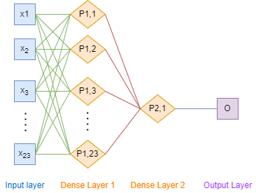
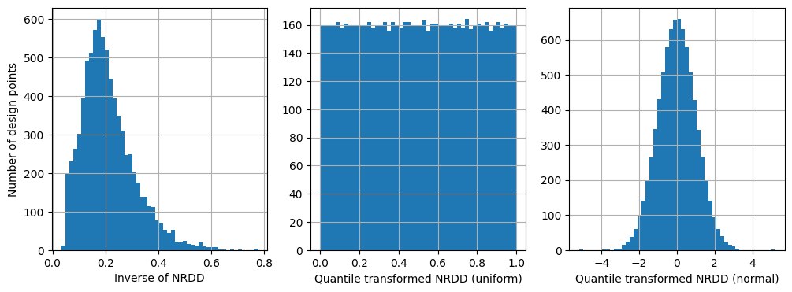
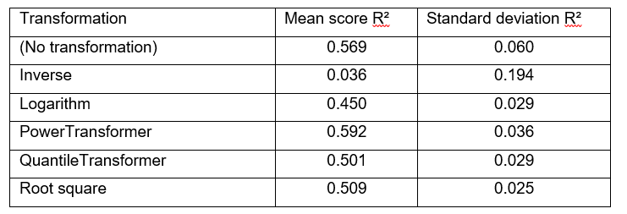
Modelling
Neural network with Keras
Transformation of the NRDD
Notes:
Neurales Netz: Struktur wird getuned
Transformation hat einen großen Einfluss: hier hat der PowerTransformer die beste Performance gezeigt

Slide 13
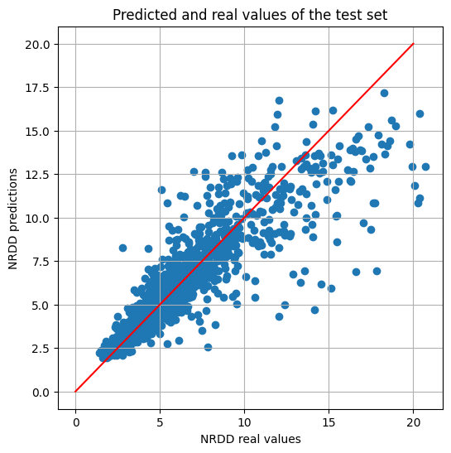
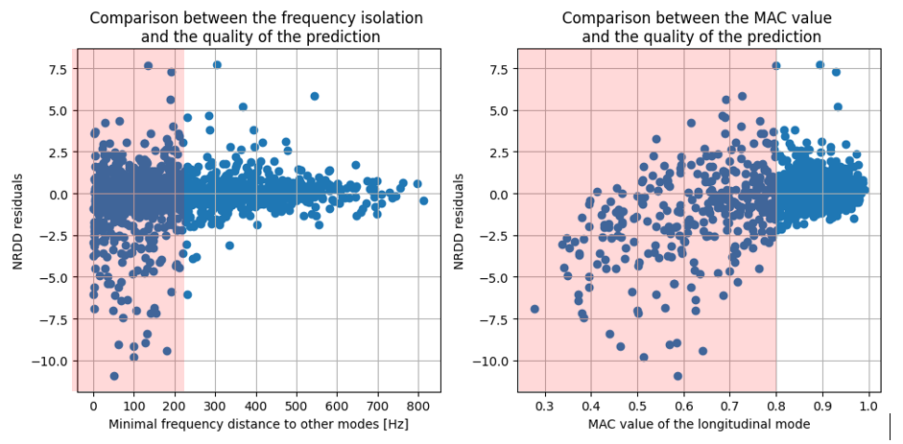
Modelling
Predictions on the test set (Residuals)
Notes:
Frequenzisolierung + Höher MAC-Wert → niedriges Residuum

Slide 14
Next steps & Conclusion
Optimizer
Navigation with the models
Cost functions
cost_long_freq
cost_all_freq
cost_nrdd
cost_total
scipy.differential_evolution
scipy.minimize
Notes:
I have completed the results‘ presentation and would like to mention the next steps:
- to deploy the model in a business point of view: we will need an optimizer
* to find the optimal geometry (or geometries)
* the optimizer will work with the predictions and navigate more efficiently in the parameter space, than the FEM simulations would
(click)
* I will define three cost functions for each target + combine them to build a total cost to be minimized
(click)
* I will start by exploring a large area of candidate space + then use a gradient-based minimizer for a fine-tuning

Slide 15
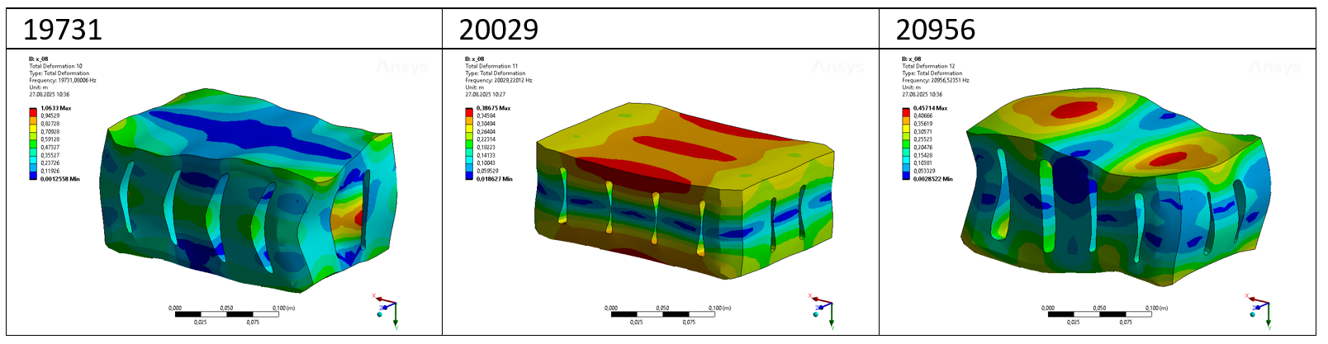
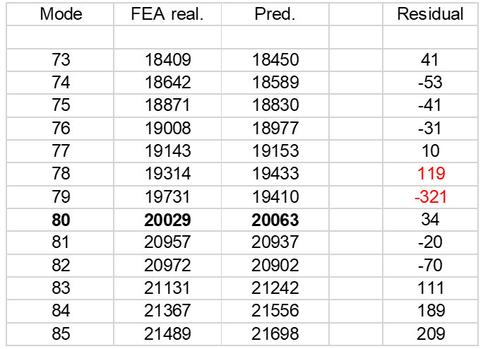
Optimizer
Lösung 1
Vergleich Vorhersage / Reale Werte

Slide 16
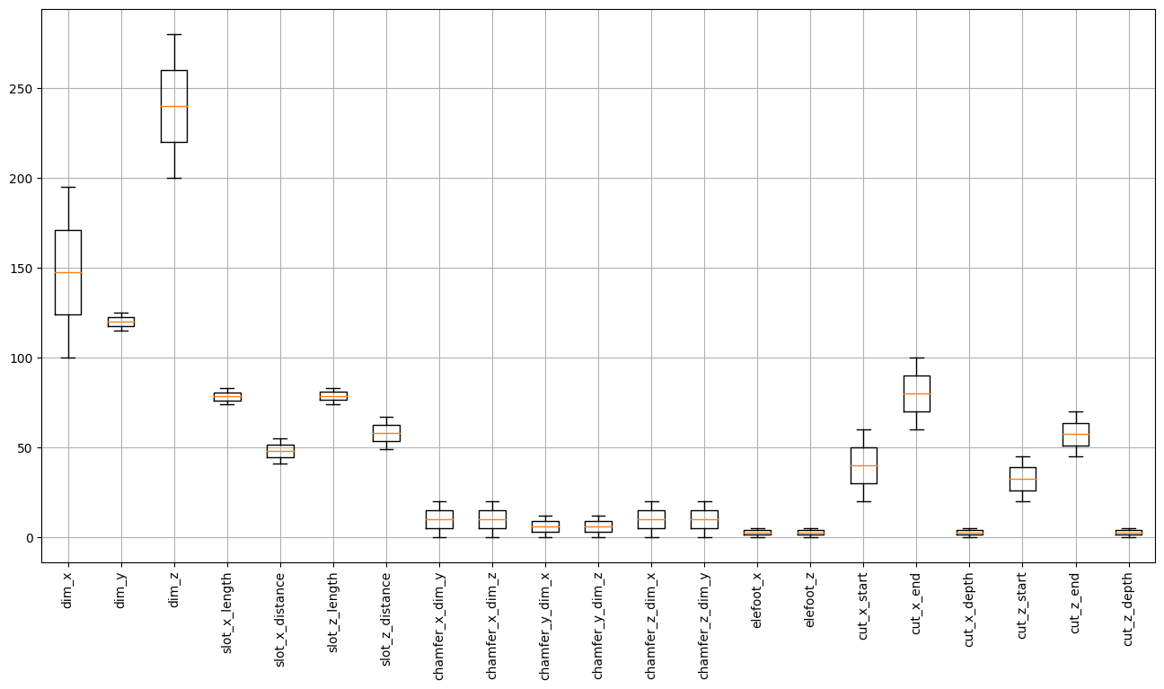
Breiterer Bereich
Variationsbereich mit konstanter Schlitzverteilung:
dim_X: 100 – (175) – 195 2 Schlitze
dim_Z: 200 – (240) – 280 4 Schlitze

Slide 17
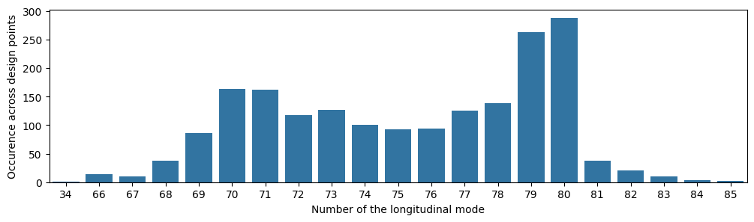
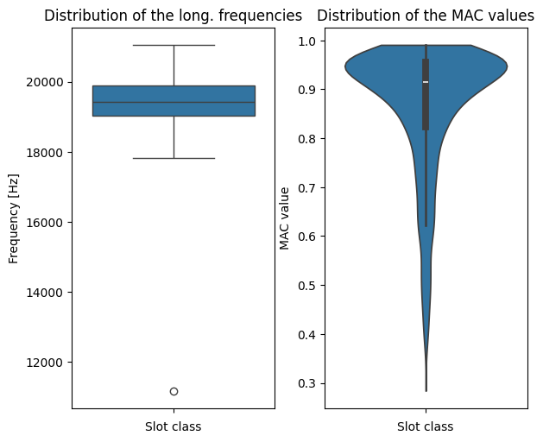
Breiterer Bereich
Verteilung der Längsmoden
Long. Frequenzen
+ MAC-Werte

Slide 18
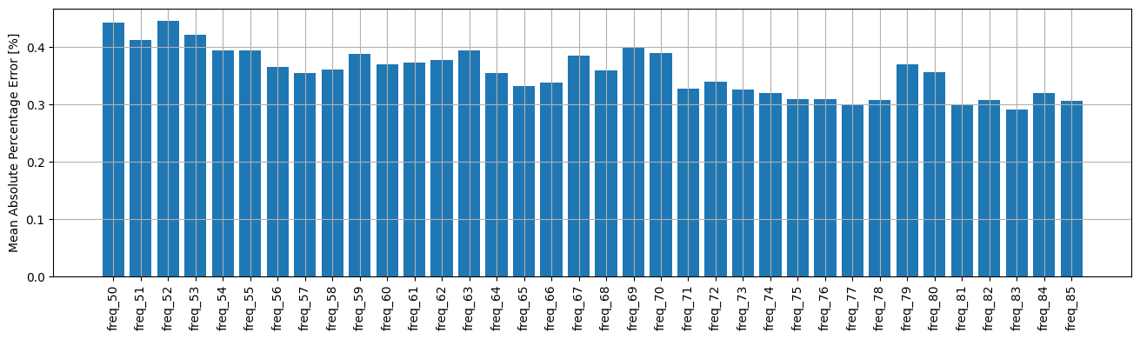
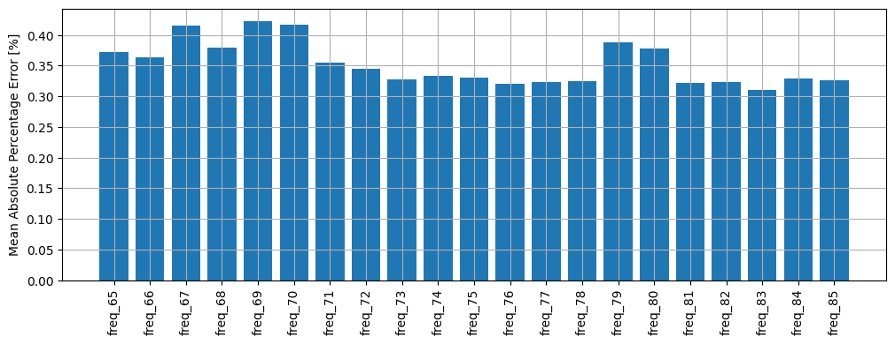
Vergleich der Performances
Alle Frequenzen
Schmaller Bereich Breiter Bereich
NRDD
Schmaller Bereich Breiter Bereich

Slide 19
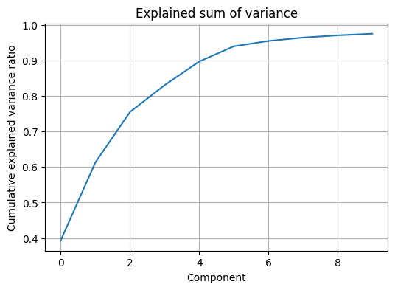
Dimensionsreduktion
PCA (Principal Component Analysis)
→ transformiert korrelierte Variablen in neue, unkorrelierte Variablen
Verschiebungen der 400 Knoten → 10 Komponenten

Slide 20
Dimensionsreduktion
Nutzen aus der Weiterbildung
1) Materialparameterermittlung
Skalierung / Transformation der Variablen
Globaler + Lokaler Optimizer
Clustering Method für die Modenzuordnung
Idee: Expl. und Target Variablen tauschen
Eigenfrequenzen sind die Eingaben
Gesucht werden die Materialkonstanten
2) Streamlit – Einfache GUI
Eingabeparameter
Datenvisualisierung

